Slide 1
ADA
Chapter – 4
Dynamic Programming
(weightage 20%)
Prepared By :
Sheetal J. Nagar,
AITS, Rajkot
Prepared By : Sheetal J. Nagar

Slide 2
Topics Covered
Introduction
The Principle of Optimality
Problem Solving using Dynamic Programming :
  Calculating the Binomial Coefficient
  Making Change Problem
  Assembly Line-Scheduling
  0-1 Knapsack problem
  All Points Shortest path
  Matrix chain multiplication
  Longest Common Subsequence
Prepared By : Sheetal J. Nagar

Slide 3
Introduction
Dynamic Programming is typically applied to the optimization problems.
Such problems can have many possible solutions.
Each Solution has a value, and we wish to find an optimal (best) solution with optimal (maximum or minimum) value.
Dynamic programming is a technique for solving problems with overlapping sub problems.
In this method each sub problem is solved only once. The result of each sub problem is recorded into a table from which we can obtain the solution of main problem.
Prepared By : Sheetal J. Nagar

Slide 4
Steps of Dynamic Programming
  Characterize the structure of an optimal solution. (i.e. Develop a mathematical notation that can express solution for the given problem)
  Recursively defines the value of an optimal solution.
  Compute the value of an optimal solution in a bottom-up fashion.
  From computed information, Construct an optimal solution.
Prepared By : Sheetal J. Nagar

Slide 5
Principle of optimality
The dynamic programming algorithm obtains the solution using ‘principle of optimality’.
The principle of optimality states that “In an optimal sequence of decisions (or choices), each subsequence must also be optimal”.
When it is not possible to apply the principle of optimality it is almost impossible to obtain the solution using the dynamic programming.
Prepared By : Sheetal J. Nagar

Slide 6
Problems that can be solved using
Dynamic Programming
Calculating the Binomial Coefficient
Making Change Problem
0/1 Knapsack problem
Matrix chain multiplication
Assembly Line-Scheduling
All Points Shortest path
Longest Common Subsequence and many more
Prepared By : Sheetal J. Nagar

Slide 7
Divide and Conquer | Dynamic Programming
1) The problem is divided into sub problems. All sub problems are solved independently. Finally all the solutions of the sub problems are combined to get the solution of given problem. | 1) All the possible solutions to a problem are obtained and the solution with optimal value becomes the solution of the problem.
2) It uses Top-Down approach. | 2) It uses Bottom-Up approach.
3) It uses Recursion. | 3) It uses Iteration.
4) Each sub problem is independent of each other. | 4) Sub problems is dependent and overlapping.
5) It splits inputs at specific points. | 5) It splits inputs at each and every possible points.
6) Lots of repetition of work; so It is less efficient. | 6) No repetition of work; so It is more efficient.
7) Key to Divide and Conquer is ‘Division’ into sub problems. | 7) Key to Divide and Conquer is ‘Remembering’.
8) Ex. Binary Search, Merge Sort, Quick Sort | 8) Ex. Making Change Problem, Matrix Chain Multiplication, 0/1 Knapsack
Prepared By : Sheetal J. Nagar

Slide 8
Greedy Algorithms | Dynamic Programming
1) Optimal Solution is not guaranteed. | 1) Optimal Solution is guaranteed.
2) It focuses on locally optimal solution. | 2) It focuses on globally optimal solution.
3) So, it doesn’t consider all the possible solutions of a problem. | 3) So, it considers all the possible solutions of a problem.
4) Sub problems do not overlap. | 4) Sub problems overlap.
5) It does less work. | 5) It does more work.
6) Ex. Minimum Spanning Tree, Huffman Code, Fractional Knapsack problem | 6) Ex. Making Change Problem, Matrix Chain Multiplication, 0/1 Knapsack problem
Prepared By : Sheetal J. Nagar

Slide 9


1) Binomial coefficient
Binomial coefficient is the coefficient of any terms in expansion of (a+b)^{n}
It is denoted by c(n,k) or 0 ≤ k ≤ n
The formula for computing binomial coefficient is
Optimal Substructure (Formula)
C(n , k) = C(n-1 , k-1) + C(n-1 , k)
C(n , 0) = 1
C(n , n) = 1
Prepared By : Sheetal J. Nagar

Slide 10
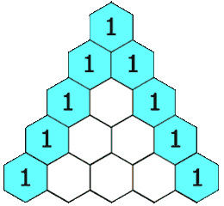
Pascal’s Triangle
Prepared By : Sheetal J. Nagar

Slide 11
Example : Find Binomial Coefficient for C(5,2)
 | 0 | 1 | 2 | 3 | 4 | 5
0 | 1
1 | 1 | 1
2 | 1 | 2 | 1
3 | 1 | 3 | 3 | 1
4 | 1 | 4 | 6 | 4 | 1
5 | 1 | 5 | 10 | 10 | 5 | 1
Solution : C(5,2) = 10
Prepared By : Sheetal J. Nagar

Slide 12
Algorithm : Binomial (n,k)
for ( i ← 0 to n ) do
{
for ( j = 0 to min(i, k) ) do
{
if ( j==0 or j==i ) then
{
C[i , j] ← 1
}
else
{
C[i, j] ← C[ i-1 , j-1 ] + C[ i-1 , j ]
}
}
}
return C [n, k]
Prepared By : Sheetal J. Nagar

Slide 13
Ex 3) Given the coins of 25, 10, 4 units, make change of 41 units.
Solution :
Greedy Method : 25 + 10 = 35 units
Now 6 units are required to be added, but no multiple of 4 can produce 6. So, Greedy approach fails here to produce the result
(as steps are not revocable here.)
Dynamic Method : 25 + 4 + 4 + 4 + 4 = 41 units
5 coins are used.
Dynamic method is able to produce the result when greedy approach fails.
Prepared By : Sheetal J. Nagar

Slide 14
2) Making Change Problem
Suppose there are some coins of different values.
“The aim of making change is to pay the desired amount of money using as few coins as possible.”
For making change problem dynamic programming is used.
The reason why greedy approach is not used here is:
  Greedy approach produces less efficient result.
  In some cases greedy approach is not able to produce result, even though it is possible.
Prepared By : Sheetal J. Nagar

Slide 15
Ex 1) Given the coins of 1,4,6 units, make change of 9 units.
Solution :
Greedy Method : 6 + 1 + 1 + 1 = 9 units
4 coins are used.
Dynamic Method : 4 + 4 + 1 = 9 units
3 coins are used.
So, dynamic method is more efficient in this approach.
Prepared By : Sheetal J. Nagar

Slide 16
Ex 2) Given the coins of 1,3,4 units, make change of 6 units.
Solution :
Greedy Method : 4 + 1 + 1 = 6 units
3 coins are used.
Dynamic Method : 3 + 3 = 6 units
2 coins are used.
Dynamic method is more efficient in this approach.
Prepared By : Sheetal J. Nagar

Slide 17
Making change problem using dynamic programming
We need to generate table c[n][N]
  n = number of denominations
  N = number of units that you need to make change
Prepared By : Sheetal J. Nagar

Slide 18
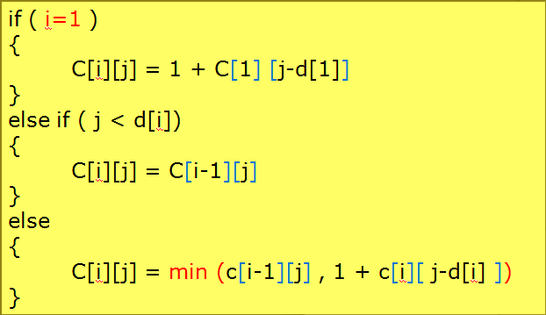
Optimal Substructure (Formula)
i=1
j < d[i]
Prepared By : Sheetal J. Nagar

Slide 19
Ex 1) Denominations: d₁=1, d₂=4, d₃=6
        Make a change of Rs. 8
 | j → | 0 | 1 | 2 | 3 | 4 | 5 | 6 | 7 | 8
i=1 | d₁=1 | 0 | 1 | 2 | 3 | 4 | 5 | 6 | 7 | 8
i=2 | d₂=4 | 0 | 1 | 2 | 3 | 1 | 2 | 3 | 4 | 2
i=3 | d₃=6 | 0 | 1 | 2 | 3 | 1 | 2 | 1 | 2 | 2
1
2
Solution : 2 coins are required.
4 + 4 = 8 units
Prepared By : Sheetal J. Nagar

Slide 20
Ex 2) Denominations: d₁=1, d₂=4, d₃=10
        Make a change of Rs. 13
 | j → | 0 | 1 | 2 | 3 | 4 | 5 | 6 | 7 | 8 | 9 | 10 | 11 | 12 | 13
i=0 |  | 0 | 0 | 0 | 0 | 0 | 0 | 0 | 0 | 0 | 0 | 0 | 0 | 0 | 0
i=1 | d₁=1 | 0 | 1 | 2 | 3 | 4 | 5 | 6 | 7 | 8 | 9 | 10 | 11 | 12 | 13
i=2 | d₂=4 | 0 | 1 | 2 | 3 | 1 | 2 | 3 | 4 | 2 | 3 | 4 | 5 | 3 | 4
i=3 | d₃=10 | 0 | 1 | 2 | 3 | 1 | 2 | 3 | 4 | 2 | 3 | 1 | 2 | 3 | 4
1
2
3
4
Solution : 4 coins are required.
4 + 4 + 4 + 1 = 13 units
Prepared By : Sheetal J. Nagar

Slide 21
Algorithm : Making Change (D[1..n],N)
for (i ← 0 to n ) do
{ for (j ← 0 to N ) do
{ if (i=0 || j=0) then
C[i][j] = 0
else if ( i=1) then
C[i][j] = 1 + C[1][j-d[i]])
else if (j < d[i]) then
C[i][j] = C[i-1][j]
else
C[i][j] = MIN(C[i-1][j], 1 + C[i][j-d[i]])
}
}
Prepared By : Sheetal J. Nagar

Slide 22
Algorithm : Making Change (D[1..n],N)
Print (“C[n][N]”)
Print (“ SELECTED COINS : ")
i=n
j=N
while(j>0) do
{
if (C[i][j] != C[i-1][j]) then
Print (d[i])
j=j-d[i]
else
i=i-1
}
Prepared By : Sheetal J. Nagar

Slide 23
3) 0-1 Knapsack Problem
We have n objects and a knapsack.
Object i has positive weight wi and profit pi for i=1,2,…n
The knapsack can carry at most weight W.
Our aim is to fill the knapsack in such a way that “Maximizes the profit” of the included objects, while satisfying the capacity constraint.
Since this is a 0-1 Knapsack problem so we can either take an entire item or reject it completely. We can not break an item and fill the knapsack.
Prepared By : Sheetal J. Nagar

Slide 24

Optimal Substructure (Formula)
Initially
Table[ i , 0 ] = 0
Table[ 0 , j ] = 0
if(j<wi)
{
Table[i,j] = Table[ i-1 , j]
}
if(j>=wi)
{
Table[i,j] = Max (Table[ i-1 , j] , vi + Table[i-1 , j - wi] )
}
Prepared By : Sheetal J. Nagar

Slide 25
Ex 1) Find optimal solution for the knapsack problem.
Item | Weight | Value
1 | 2 | 3
2 | 3 | 4
3 | 4 | 5
4 | 5 | 6
W = 5
Knapsack Capacity
Solution :
Step 1:
Arrange all the items in the ascending order of their values.
(Here, it is already in ascending order.)
Prepared By : Sheetal J. Nagar

Slide 26
Step 2 : Fill the Table
n=4
W = 5
Item i | Weight | Value | 0 | 1 | 2 | 3 | 4 | 5
0 |  |  | 0 | 0 | 0 | 0 | 0 | 0
1 | w1 = 2 | v1 = 3 | 0 | 0 | 3 | 3 | 3 | 3
2 | w2 = 3 | v2 = 4 | 0 | 0 | 3 | 4 | 4 | 7
3 | w3 = 4 | v3 = 5 | 0 | 0 | 3 | 4 | 5 | 7
4 | w4 = 5 | v4 = 6 | 0 | 0 | 3 | 4 | 5 | 7
✔
✔
Output :
Items Selected {1,2}
Total value of the selected items=7
Total value of selected items = 7
Prepared By : Sheetal J. Nagar

Slide 27
Ex 2) Find optimal solution for the knapsack problem.
Item | Weight | Value
1 | 2 | 3
2 | 3 | 5
3 | 4 | 6
4 | 5 | 10
W = 8
Knapsack Capacity
Solution :
Step 1:
Arrange all the items in the ascending order of their values.
(Here, it is already in ascending order.)
Prepared By : Sheetal J. Nagar

Slide 28
Step 2 : Fill the Table
n=4
W = 8
Item i | Weight | Value | 0 | 1 | 2 | 3 | 4 | 5 | 6 | 7 | 8
0 |  |  | 0 | 0 | 0 | 0 | 0 | 0 | 0 | 0 | 0
1 | w1 = 2 | v1 = 3 | 0 | 0 | 3 | 3 | 3 | 3 | 3 | 3 | 3
2 | w2 = 3 | v2 = 5 | 0 | 0 | 3 | 5 | 5 | 8 | 8 | 8 | 8
3 | w3 = 4 | v3 = 6 | 0 | 0 | 3 | 5 | 6 | 8 | 9 | 11 | 11
4 | w4 = 5 | v4 = 10 | 0 | 0 | 3 | 5 | 6 | 10 | 10 | 13 | 15
✔
✔
Output :
Items Selected {2,4}
Total value of the selected items=15
Total value of selected items = 15
Prepared By : Sheetal J. Nagar

Slide 29
Algorithm : Knapsack_Dynamic( w[1-n], v[1-n], W )
for ( i ← 0 to n ) do
{ for ( i ← 0 to W ) do
{
if (i=0 || j=0) then
Table[i,j] = 0
else if ( j < weight[i]) then
Table[i,j] = Table[ i-1 , j]
else
Table[i,j] = Max (Table[ i-1 , j] , vi + Table[i-1 , j - wi]
}
}
C[i , j] ← 1
Prepared By : Sheetal J. Nagar

Slide 30
Print(“table[n][W]”)
Print(“Selected items are as follows :”)
i=n
j=W
while(i>0 && j>0) do
{
if (table[i , j] != table[i-1 , j]) then
Print(i)
j=j-wi
i=i-1
else
i=i-1
}
C[i , j] ← 1
Prepared By : Sheetal J. Nagar

Slide 31
4) Matrix Chain Multiplication
Given a sequence of matrices, find the most efficient way to multiply these matrices together.
“Our goal is not actually to perform the multiplications, but to decide in which order to perform the multiplications”.
No matter how we parenthesize the product, the result will be the same because matrix multiplication is associative.
Prepared By : Sheetal J. Nagar

Slide 32
Matrix Chain Multiplication
C = A * B
If A is of size p * q , B is of size q * r
then C = is of size p * r
Ex.
(A1 . A2) . A3 takes (5 * 4 * 6 ) + ( 5 * 6 * 2) = 180
A1 . ( A2 . A3 ) takes (5 * 4 * 2 ) + (4 * 6 * 2) = 88
So, A1 . ( A2 . A3 ) is much cheaper with optimal cost 88, even though both lead to same final answer.
Matrix | Dimension
A1 | 5 * 4
A2 | 4 * 6
A3 | 6 * 2
Prepared By : Sheetal J. Nagar

Slide 33

Optimal Substructure (Formula)
if (i = j)
M[i , j] = 0
else
M[i , j] = Min (Table[ i , k] + Table[ k+1 , j] + P_{i-1} P_{k} P_{j} )
i ≤ k < j
Prepared By : Sheetal J. Nagar

Slide 34
Ex 1) Find optimal Sequence of Matrix Chain Multiplication.
Solution :
Matrix | Dimension
A1 | 5 × 4
A2 | 4 × 6
A3 | 6 × 2
A4 | 2 × 7
p₀ | = | 5
p₁ | = | 4
p₂ | = | 6
p₃ | = | 2
p₄ | = | 7
Prepared By : Sheetal J. Nagar

Slide 35
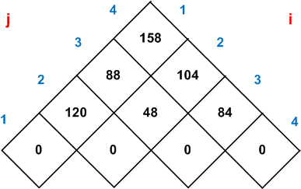
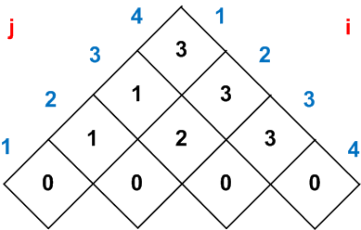
Table (i,j)
Sequence (i,j)
Total Cost of Matrix Chain Multiplication = 158
Optimal Sequence can be found from this table.
Note : Refer Lecture notes to know how to fill these tables.
Prepared By : Sheetal J. Nagar

Slide 36
How to Print Optimal Parenthesis?
Algorithm : Print(S, i, j)
if i == j
print “A”i
else
print “(”
Print(S, i , S[i,j])
Print(S, S[i,j] + 1 , j)
print “)”
Prepared By : Sheetal J. Nagar

Slide 37
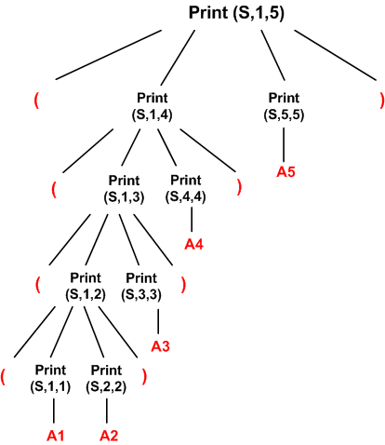

Optimal Sequence :
( ( ( ( A1 A2 ) A3 ) A4 ) A5 )
Prepared By : Sheetal J. Nagar

Slide 38
Ex 2) Find optimal Sequence of Matrix Chain Multiplication.
Solution :
Matrix | Dimension
A1 | 1 × 5
A2 | 5 × 4
A3 | 4 × 3
A4 | 3 × 2
A5 | 2 × 1
p₀ | = | 1
p₁ | = | 5
p₂ | = | 4
p₃ | = | 3
p₄ | = | 2
p₅ | = | 1
Prepared By : Sheetal J. Nagar

Slide 39
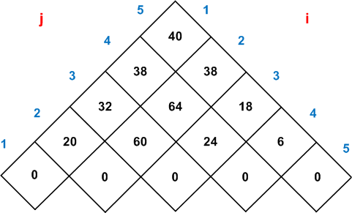
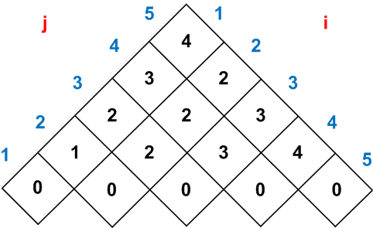
Table (i,j)
Sequence (i,j)
Total Cost of Matrix Chain Multiplication = 40
Optimal Sequence can be found from this table.
Note : Refer Lecture notes to know how to fill these tables.
Prepared By : Sheetal J. Nagar

Slide 40
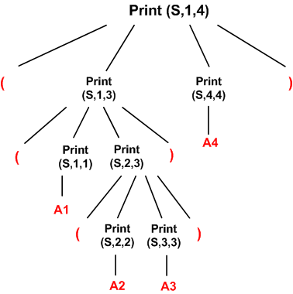

Optimal Sequence :
( ( A1 ( A2 A3 ) ) A4 )
Prepared By : Sheetal J. Nagar

Slide 41
6) Assembly line scheduling
A car factory has two assembly lines, each with n stations.
Each line has n stations: S1,1, . . . , S1,n and S2,1, . . . , S2,n.
Entry times are: e1 and e2; exit times are: x1 and x2
The parallel stations S1,j and S2,j perform the same function but can take different amounts of time.
A car chassis must pass
  Through each of the n stations in order,
  Parts added to it at each station,
  and a Finished auto exits at the end of the line.
“Our goal is to find the fasted way to assemble the product, thus to minimize the time it will take to build a completed auto like car.”
Prepared By : Sheetal J. Nagar

Slide 42
Assembly line scheduling
After going through a station, can either:
  stay on same line at no cost, or
  transfer to other line with transportation cost.
Prepared By : Sheetal J. Nagar

Slide 43

Optimal Substructure (Formula)
e₁ + a_{1,1} if j = 1
f₁[j] =
min(f₁[j - 1] + a_{1,j} ,f₂[j -1] + t_{2,j-1} + a_{1,j}) if j ≥ 2
e₂ + a_{2,1} if j = 1
f₂[j] =
min(f₂[j - 1] + a_{2,j} ,f₁[j -1] + t_{1,j-1} + a_{2,j}) if j ≥ 2
Prepared By : Sheetal J. Nagar

Slide 44
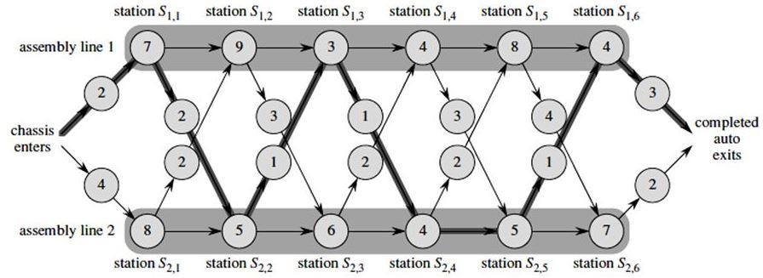
i \ j |  | 1 | 2 | 3 | 4 | 5 | 6 | exit
f₁[j] | Through 1 Through 2 | 2+7 = 9 | 9 +9 = 18 12+2+9 = 23 | 18 +3 = 21 16+1+3 = 20 | 20 +4 = 24 22+2+4 = 28 | 24 +8 = 32 25+2+8 = 35 | 32 +4 = 36 30+1+4 = 35 | 35+3 = 38 f*, l*=1
f₂[j] | Through 2 Through 1 | 4+8 = 12 | 12 +5 = 17 9+2+5 = 16 | 16 +6 = 22 18+3+6 = 27 | 22 +4 = 26 20+1+4 = 25 | 25 +5 = 30 24+3+5 = 32 | 30 +7 = 37 32+4+7 = 43 | 37+2 = 39
Prepared By : Sheetal J. Nagar

Slide 45
i \ j |  | 1 | 2 | 3 | 4 | 5 | 6 | exit
f₁[j] | Through 1 Through 2 | 2+7 = 9 | 9 +9 = 18 12+2+9 = 23 | 18 +3 = 21 16+1+3 = 20 | 20 +4 = 24 22+2+4 = 28 | 24 +8 = 32 25+2+8 = 35 | 32 +4 = 36 30+1+4 = 35 | 35+3 = 38 f*, l*=1
f₂[j] | Through 2 Through 1 | 4+8 = 12 | 12 +5 = 17 9+2+5 = 16 | 16 +6 = 22 18+3+6 = 27 | 22 +4 = 26 20+1+4 = 25 | 25 +5 = 30 24+3+5 = 32 | 30 +7 = 37 32+4+7 = 43 | 37+2 = 39
1 2 3 4 5 6
l*
1
2
1
2
2
1
Prepared By : Sheetal J. Nagar

Slide 46
Prepared By : Sheetal J. Nagar

Slide 47
7) Floyd – Warshall algorithm
It is used for solving ‘All Pairs Shortest Path’ problem.
“The problem is to find shortest distances between every pair of vertices in a given weighted directed Graph”.
Prepared By : Sheetal J. Nagar

Slide 48
Algorithm : Floyd-Warshall(D[1..n, 1..n])
for (k ← 1 to n) do
{ for (i ← 1 to n) do
{ for (j ← 1 to n) do
{
D[i,j] ← min(D[i,j], D[i,k]+ D[k,j])
}
}
}
return D
Prepared By : Sheetal J. Nagar

Slide 49
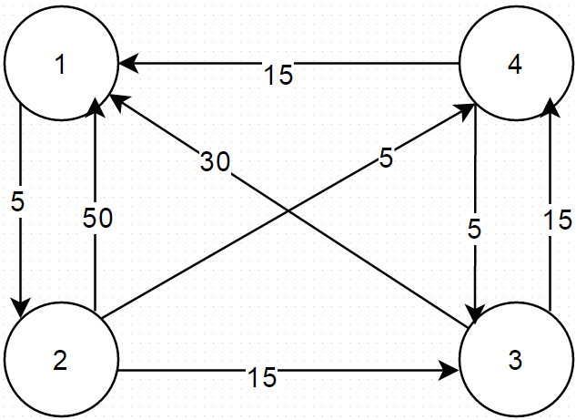
Example 1) Apply Floyd algorithm to find all pairs shortest path from the given graph
Prepared By : Sheetal J. Nagar

Slide 50
Step 1 : Compute D₀
 | 1 | 2 | 3 | 4
1
2
3
4
-
5
∞
∞
50
-
15
5
D₀ =
30
∞
-
15
15
∞
5
-
Prepared By : Sheetal J. Nagar

Slide 51
Step 2 : Compute D₁
Consider 1 as intermediate node.
So,
3 - 1 - 2 is possible → giving 35
4 - 1 - 2 is possible → giving 20
✔
✔
 | 1 | 2 | 3 | 4
1
2
3
4
-
5
∞
∞
50
-
15
5
D₁ =
30
35
-
15
15
20
5
-
Prepared By : Sheetal J. Nagar

Slide 52
Step 3 : Compute D₂
Consider 1 and 2 as intermediate nodes.
So,
1 - 2 - 3 is possible → giving 20
1 - 2 - 4 is possible → giving 10
✔
✔
 | 1 | 2 | 3 | 4
1
2
3
4
-
5
20
10
50
-
15
5
D₂ =
30
35
-
15
15
20
5
-
Prepared By : Sheetal J. Nagar

Slide 53
Step 4 : Compute D₃
Consider 1,2 and 3 as intermediate nodes.
So,
4 - 3 - 1 is possible → giving 35 > 15
2 - 3 - 1 is possible → giving 10
2 - 3 - 4 is possible → giving 30 > 5
×
✔
×
 | 1 | 2 | 3 | 4
1
2
3
4
-
5
20
10
50
-
15
5
D₃ =
30
35
-
15
15
20
5
-
Prepared By : Sheetal J. Nagar

Slide 54
Step 5 : Compute D₄
Consider 1,2,3 and 4 as intermediate nodes.
So,
3 - 4 - 1 is possible → giving 30 (same as current cost)
2 - 4 - 1 is possible → giving 20
2 - 4 - 3 is possible → giving 10
1 - 2 - 4 - 3 is possible → giving 15
✔
✔
✔
 | 1 | 2 | 3 | 4
1
2
3
4
-
5
15
10
20
-
10
5
D₄ =
30
35
-
15
This matrix shows the shortest distance
between all the pairs of the vertices
15
20
5
-
Prepared By : Sheetal J. Nagar

Slide 55
8) Longest Common Subsequence (LCS)
A subsequence is a sequence that appears in the same relative order, but not necessarily contiguous.
Given two sequences X and Y , we say that a sequence Z is a common subsequence of X and Y if Z is a subsequence of both X and Y .
“Our goal here is to find such longest Z, that is longest common Subsequence”.
Prepared By : Sheetal J. Nagar

Slide 56

Optimal Substructure (Formula)
if(A[i]=B[j]) then
C[i,j]=C[i-1,j-1]+1
D[i,j]= 
else if(C[i-1,j]>=C[i,j-1]) then
C[i,j]=C[i-1,j]
D[i,j]= ⬆
else
C[i,j]=C[i,j-1]
D[i,j]= ⬅
Prepared By : Sheetal J. Nagar

Slide 57
Example: Find LCS of given two strings using Dynamic Programming.
X = < A, B, C, B, D, A, B> and Y = <B, D, C, A, B, A>
x_{i}
A
B
C
B
D
A
B
y_{j} | B | D | C | A | B | A
0
0
0
0
0
0
0
0
0
0
0
1
1
1
0
1
1
1
1
2
2
0
1
1
2
2
2
2
0
1
1
2
2
3
3
LCS = BCBA
0
1
2
2
2
3
3
0
1
2
2
3
3
4
0
1
2
2
3
4
4
Prepared By : Sheetal J. Nagar

Slide 58
Algorithm : LCS (A[1..m], B[1..n])
for ( i ← 0 to m ) do
C[i,0] = 0
for ( j ← 0 to n ) do
C[0,j]=0
for(i ← 1 to m ) do
{ for(j ← 1 to n ) do
{
if(A[i]=B[j]) then
C[i,j]=C[i-1,j-1]+1
D[i,j]= 
}
}
else if(C[i-1,j]>=C[i,j-1])
C[i,j]=C[i-1,j]
D[i,j]= ⬆
else
C[i,j]=C[i,j-1]
D[i,j]= ⬅
Prepared By : Sheetal J. Nagar

Slide 59
Algorithm : Display_LCS (D, C, i, j)
for ( i = 0 or j = 0) do
  return
if (D[i,j]= ) then
{
Display_LCS(D,C,i-1,j-1)
print “A”i
}
else if(D[i,j]= ⬆) then
{
Display_LCS(D,C,i-1,j)
}
else
{
Display_LCS(D,C,i,j-1)
}
Prepared By : Sheetal J. Nagar

Slide 60
Reference:
1. “Introduction to Algorithms”, Thomas H. Cormen, Charles E. Leiserson, Ronald L. Rivest and Clifford Stein, PHI.
Prepared By : Sheetal J. Nagar

Slide 61

Prepared By : Sheetal J. Nagar

